Slide 1
Lecture on Demography
Course Instructor; Mrisho Ayoub J.

Slide 2
Introduction
Demography is the study of the vital statistics of a population and how they change over time
Death rates and birth rates
Are of particular interest to demographers
It is also defined as the branch of sociology that studies human behavior by analyzing statistical information

Slide 3
Introduction……
It comprises a set of techniques by which data collected in censuses, surveys and record-keeping systems are described, summarized and manipulated
It can analyzes population changes over time or space in response to time, birth, migration, and death.

Slide 4
Why studying Demography and population
Demography as an academic discipline seeks to explore the dynamics of human populations in relation to the changes in their sizes, structures and distributions.
Population changes have implications for the environment, employment, family relations, health, and urbanization
The study of demography requires extensive and accurate data to be able to describe, analyses and understanding the population phenomenon

Slide 5
Tanzania, Africa and World at large needs to address its numerous 21st century challenges.
These include stemming the tide of HIV/AIDS, ensuring safe reproductive health, improving infant and child survival, managing migration and urbanization and expediting economic development while safeguarding the environment.

Slide 6
The interconnected nature of all these issues has necessitated the adoption of an interdisciplinary approach to tackling population problems.
For example, one cannot investigate the impact of HIV/AIDS on family structure without thinking about gender, unemployment, migration, etc.

Slide 7
Population
Population is the total number of human beings inhabiting a country, town or area at a given period of time at a moment.
A population is a group of individuals of the same species living in the same general area
Population size; is simply the number of individual human in a population
Population distribution; is the spread of people across the world, i.e. where do people live

Slide 8
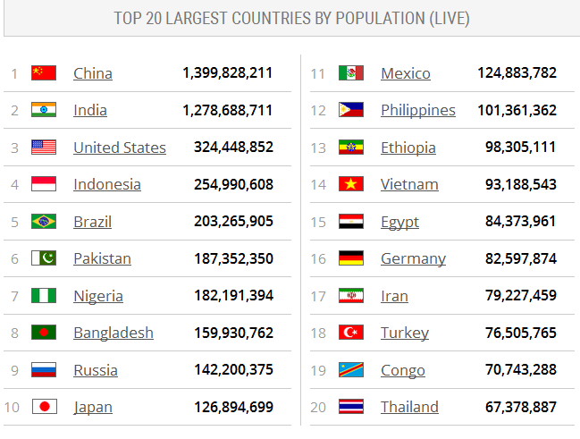
Distribution
http://www.worldometers.info/world-population/

Slide 9
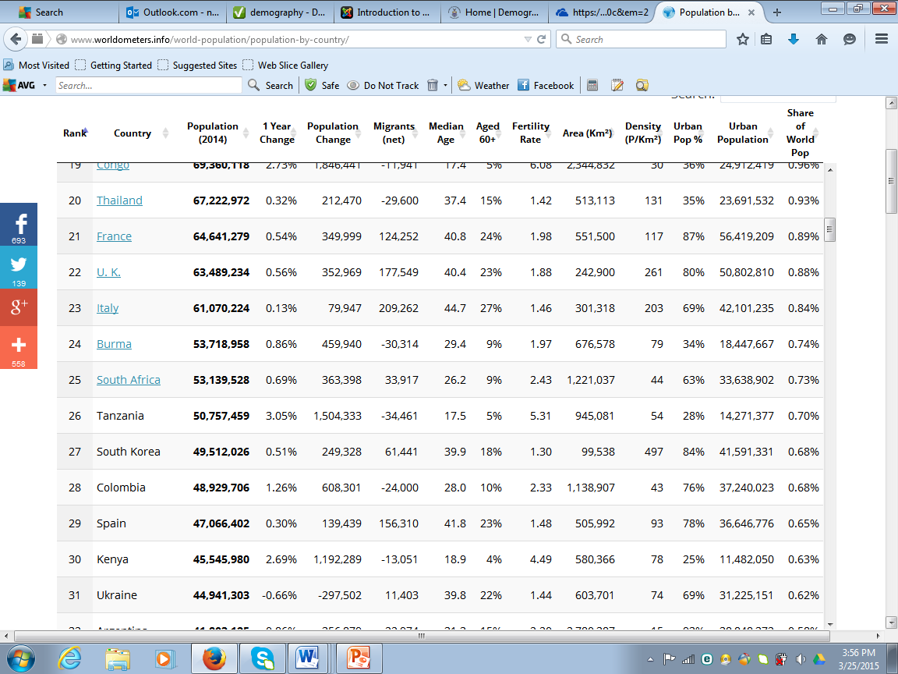
Distribution

Slide 10
Pop Cont…..
Population Structure; is basically what makes up or composition of a population.
Population structure of a place shows how the population is divided up between males and females of different age groups
Population density; is a measurement of population size per unit area/ population size divided by total land area

Slide 11
World population situation (Population Size and distribution)
The world human population is the total number of living humans on Earth and majority of People live in the developing world
The world's population is spread unevenly across the globe with small concentrations of large numbers of people living in the same area. Many people today are living in cities
There are several physical and human factors to explain this

Slide 12
Physical Factors
Climate
People prefer to live in temperate climates where there is enough rainfall and no extremes of temperature. A lack of fresh water for drinking or irrigation stops people living in an area.
Very high temperatures make farming difficult
Very cold temperatures make it difficult to grow crops.
Areas with high humidity are also uncomfortable places to live and can have disease such as malaria.

Slide 13
Physical Factors Cont..
Relief
Steep slopes make the use of machinery difficult.
Steep slopes also make it difficult to build houses, roads and railways.
High, mountainous areas are also cold making it difficult to grow crops.
Soils in these areas are often thin and acidic too.
High mountainous areas are often remote so are difficult to access.

Slide 14
Physical Factors Cont…
Natural Resource
Areas with few natural resources, e.g. coal, mean there is a lack of industry and therefore a lack of employment opportunities.
Scenery is a resource and can attract tourists therefore brings job opportunities.
Soils
Areas with fertile soils, e.g. river deltas, means that crops can be grown to feed the population.
Poor soils with few nutrients means there will be a low agricultural output.

Slide 15
Human Factors
Employment Opportunities
Jobs, e.g. in primary industries like fishing, encourage people to move there to find work.
Communications
Areas with good transport links, such as roads and railways, will attract people and also industry which creates employment opportunities.
Remote areas which are isolated and have poor transport links do not attract people.

Slide 16
Sources of the population data
Censuses
Sample surveys
Vital registration

Slide 17
Censuses
Is the main source of demographic statistics in many Countries
It is define, the total number of collecting, compiling and publishing demographic economic and social data pertaining at a specific time to all person in our country or delimitated territory.
It is a good methods of recording the size, distribution and other characteristics of the population fixed interval.

Slide 18
types of Census
De facto Census
Is the type of census in which people are counted wherever they are found in the day of enumeration eg at home or market.
De jure Census
It involves an attempt of counting people by reaching individual where they are found.
Normally it involves the permanent members of the house hold

Slide 19
Merits of Censuses
A census does not suffer from sampling errors because it covers the whole population in a country or region.
The results of a census can easily be compared with the results of censuses of other countries because of its universality feature.
Since a census is taken at regular intervals, it is the most popular source of demographic data

Slide 20
Merits of Censuses Cont….
To determine the literacy and illiteracy rate of the population in the relevant age group
To obtain a detailed data about all member of the country by age and sex.
To provide social and economic information on household, housing condition such as occupancy.
To provide a complete picture of all places and persons, villages, wards, and household of a nation.

Slide 21
Demerits/Limitations of Census
It is often postponed due to lack of money. For example, the Tanzania’s 1998 censuses postponed to 2002. Census takes a long time to prepare and complete because they cover the whole country.
A census is an expensive exercise, which necessitates some developing countries to seek assistance from foreign donors in order to carry out their own censuses. Sometimes, censuses are not undertaken due to this reason.
It is difficult to collect detailed information in a census because it covers the whole population. Also due to the same problem, census is bound to have some errors.

Slide 22
Sample surveys
These are the second most important source of demographic data in most parts of Africa
These are used to obtaining quick results and assess impact programmes
Advantages (compared to census). Simple, flexible, easy to administer, and cheap in terms of cost
Disadvantages;
Have high rates of error especially during sampling
The results of findings are used to generalize the phenomena in a locality.

Slide 23
Vital registration
Vital Registration It consists of continuous registration of vital events such as births and deaths.
A vital event is defined as a major change in individual status that leads to a change in the composition of the population.
Traditionally, vital events include births and deaths but nowadays the term embraces other events such as marriage, adoption, separation, divorce and migration.

Slide 24
Limitations of Vital Registration
It is difficult to obtain the registration of birth and death events.
Accurate data on migration is also extremely difficult to obtain, especially when migrants do not pass through the official check point when crossing the political boundaries.

Slide 25
Quality of population data in LDCs
Generally there are limitation and deficiencies in the population data in the most LDCs most of the data have a lot of errors.
Errors of coverage; where person are not counted at all especially the migrant
Errors of content; errors in the recording of events

Slide 26
Uses of population Data
Uses of population data are many and varied. In general they are required for planning and administration and also for various aspects of economic and social research. Specifically demographic data is required for;
1. Estimating the future population sizes and distribution;
These are fundamental to long term planning of many public programmes eg; education needs, manpower needs and housing needs

Slide 27
Uses of population Data Cont..
2. Investigating the relationship between demographic and social economic process
3. Measuring the level and trends in the standard of living
4. Allocation of resources and services eg; Health facilities, water, schools

Slide 28
Population Change:
Population change refers to a increase or a decrease of population at time.
Population change not only implies the change in its size but also in its internal composition and structure with respect to its various characteristics and spatial distribution.
The size of the population in any area increase through birth and immigration (or in-migration) and decreases through deaths and emigration (out migration).

Slide 29
Concept of population change
Popn change is the result of interplay of:
Births;
Deaths;
Migrations: internal & international.
Natural increase is ultimate source of popn growth in world
Within a country migration can be a main determinant of popn growth

Slide 30
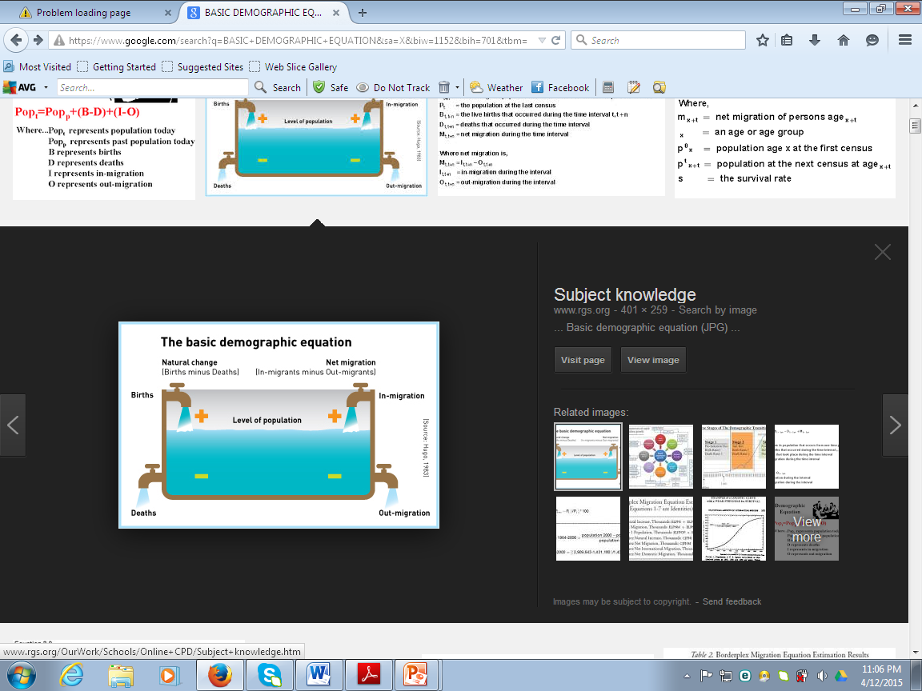

Slide 31
Reasons for variation in population trends.
The following are reasons for variation in population trends
Fertility.
Mortality.
Migration.

Slide 32
HIV/AIDS AND STDs

Slide 33
BASIC HEALTH CONCEPTS
Pathogen
Agent of diseases or something can causes diseases e.g. a bacterium or a virus
Pathogens can be spread by many methods other than direct contact, including through water, food, air, and bodily fluids (blood, semen, saliva etc

Slide 34
What are sexually transmitted diseases (STDs)?
Sexually transmitted diseases (STDs), or sexually transmitted infections (STIs), are infections that are passed from one person to another through sexual contact.
The contact is usually vaginal, oral, or anal sex. But sometimes they can spread through other intimate physical contact. This is because some STDs, like herpes are spread by skin-to-skin contact.

Slide 35
major causes of STDs
Bacteria, including chlamydia, gonorrhea, and syphilis
Viruses, including HIV/AIDS, herpes simplex virus, human papillomavirus, hepatitis B virus, cytomegalovirus (CMV), and Zika
Any STDs can be spread through sexual activity including sexual intercourse, and some STDs also are spread through oral sex and other sexual activity. Ejaculation does not have to occur for an STDs to pass from person to person.

Slide 36
There are more than 20 types of STDs, including:
Chlamydia
Genital herpes
Gonorrhea
HIV/AIDS
HPV
Pubic lice
Syphilis
Trichomoniasis
Hepatitis B

Slide 37
Who is affected by sexually transmitted diseases (STDs)?
Most STDs affect both men and women, but in many cases the health problems they cause can be more severe for women. If a pregnant woman has an STD, it can cause serious health problems for the baby.

Slide 38
What are the symptoms of sexually transmitted diseases (STDs)?
STDs don't always cause symptoms or may only cause mild symptoms. So it is possible to have an infection and not know it. But you can still pass it on to others.

Slide 39
How are sexually transmitted diseases (STDs) diagnosed?
If you are sexually active, you should talk to your health care provider about your risk for STDs and whether you need to be tested. This is especially important since many STDs do not usually cause symptoms.
Some STDs may be diagnosed during a physical exam or through microscopic examination of a sore or fluid swabbed from the vagina, penis, or anus. Blood tests can diagnose other types of STDs.

Slide 40
What are the treatments for sexually transmitted diseases (STDs)?
Antibiotics can treat STDs caused by bacteria or parasites. There is no cure for STDs caused by viruses, but medicines can often help with the symptoms and lower your risk of spreading the infection.

Slide 41
Overview of HIV and AIDS Epidemiology

Slide 42
HIV
HIV stands for Human Immunodeficiency Virus
HIV is a virus that attacks the immune system
It affects specific cells of the immune system: white blood cells called CD4 cells of T cells
When many CD4 cells are destroyed, the body can no longer defend itself against infection
In short HIV is the virus which causes AIDS

Slide 43
AIDS
AIDS stands for Acquired Immune Deficiency Syndrome/ Acquired immunodeficiency syndrome
it is the final stage of HIV infection,
AIDS is the stage of infection that occurs when immune system is badly damaged & body become vulnerable to opportunistic infections
Both the virus and the syndrome are often referred to together as HIV/AIDS

Slide 44
HIV/AIDS CAUSES &TRANSMISSION
HIV infection is caused by the human immunodeficiency virus
HIV is found in the body fluids of an infected person
i.e. semen and vaginal fluids, blood, breast milk

Slide 45
CAUSES &TRANSMISSION………
HIV can be transmitted through:
Sexual transmission
This Is a major mean of HIV transmission
The virus is passed from one person to another through sexual intercourse with infected person
This happen while having unprotected sex
when there is contact with infected sexual secretions (rectal, genital or oral mucous membranes)

Slide 46
CAUSES &TRANSMISSION …..
Parental transmission
The infected mothers can pass the infection on to their babies during pregnancy, delivering/childbirth, breast feeding
Blood transmission
blood-to-blood contact (infected blood)
HIV transmitted through blood transfusion because of careless screening and precautions

Slide 47
SYMPTOMS
Many people with HIV have no symptoms for several years
Others may develop symptoms similar to flu 2-6 six weeks after catching the virus
The symptoms can last up to four weeks
As the virus continues to multiply and destroy immune cells, infected person may develop signs and symptoms

Slide 48
IMPACT OF HIV & AIDS ON SOCIO-ECONOMIC DEVELOPMENT

Slide 49
Impact of HIV and AIDS
The impact is mapped on sectors, social services, households, demographic and on the economy in general
the HIV/AIDS pandemic on the economy, its effects manifest on :
labour supply,
labour productivity,
financial costs associated
changing composition of the labour force

Slide 50
Gender issue(s)

Slide 51
Gender issue(s) CO
Gender issues include all aspects and concerns related to women’s and men’s lives and situation in society, to the way they interrelate, their differences in access to and use of resources, their activities, and how they react to changes, interventions and policies.
Any issue or concern determined by gender-based and/or sex-based differences between women and men.

Slide 52
Gender defin.
Socially constructed gender roles and responsibilities assigned to men and women by the society
These roles are learned
Vary btn cultures
Change over time
Gender is further defined by UNDP as:
A word used to describe a set of social qualities and behaviours expected from men and women by their societies
Sex-Biological attributes of men and women
Are universal
Generally permanent

Slide 53
Gender &sex defin. Cont..
Sex-biological-given by birth-therefore cannot be changed
Gender-cultural-learned through socialization-therefore can be changed over time

Slide 54
END
THANK FOR LISTENING

